Slide 1

Medical Image Seminar
Yicheng Jiang
CUHK, Shenzhen
April 15, 2020
Notes:
The IEEE International Symposium on Biomedical Imaging (ISBI)
[sɪmˈpoʊziəm]

Slide 2
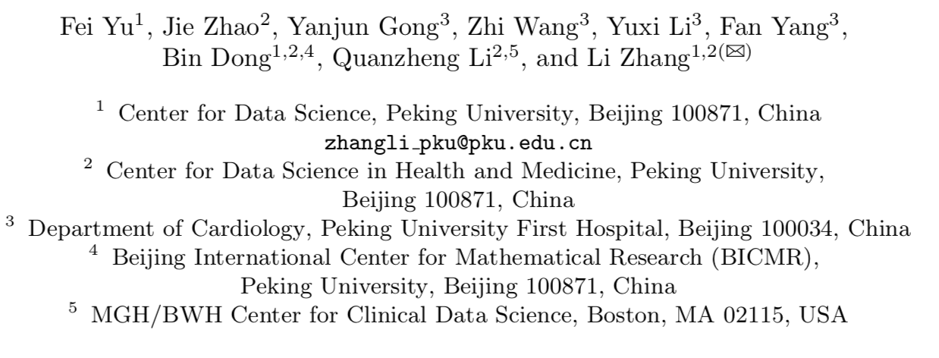
Paper Information
TITLE
Annotation-Free Cardiac Vessel Segmentation via Knowledge Transfer from Retinal Images
Authors
Acknowledgement
This work was supported by National Key R&D Program of China (No. 2018YFC0910700); The National Natural Science Foundation of China (NSFC) under Grants 81801778, 11831002; Beijing Natural Science Foundation (Z180001).
Notes:
The IEEE International Symposium on Biomedical Imaging (ISBI)
[sɪmˈpoʊziəm]

Slide 3
Background
Digital Subtraction Angiography (DSA)
Quantitative measurement of coronary arteries in medical images is important for the diagnosis, prevention and therapeutic evaluation of related diseases.
In the diagnosis of coronary diseases, digital subtraction angiography (DSA) has been widely used and considered the “gold standard”.
Quantitatively segmentation blood vessels in DSA is necessary
Notes:
The IEEE International Symposium on Biomedical Imaging (ISBI)
[sɪmˈpoʊziəm]

Slide 4
Problem
Difficulties
Due to the complexity of the vascular morphology, unsupervised methods are difficult to obtain a clinically satisfactory segmentation of coronary arteries.
Supervised learning relies heavily on pixel-level image annotation, which is often expensive, time-consuming, and even impossible to access especially for coronary artery segmentation.
Method
To solve the problem of the lack of DSA vessel annotation, a constraint of shape consistency (SC-GAN) is proposed to transfer the knowledge of retinal vessel segmentation to the coronary artery segmentation
Notes:
The IEEE International Symposium on Biomedical Imaging (ISBI)
[sɪmˈpoʊziəm]

Slide 5
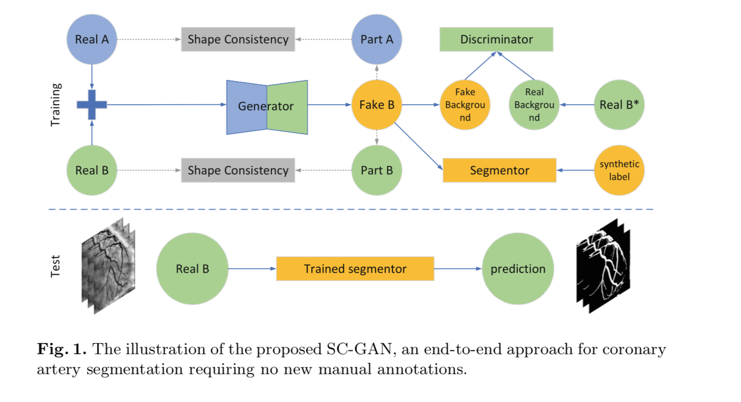
Method
Structure (SC-GAN)
Notes:
The IEEE International Symposium on Biomedical Imaging (ISBI)
[sɪmˈpoʊziəm]

Slide 6
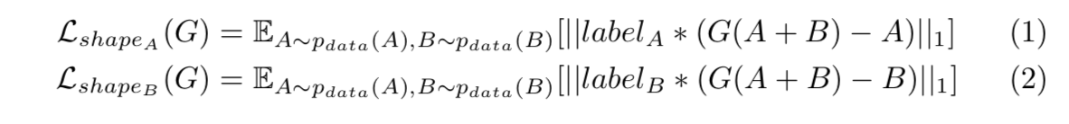
Method
Generator:
A shape-consistent loss (l1 loss) is then used to regularize the content of the vessel regions in Fake B to be consistent with the corresponding regions in the original images,
Notes:
The IEEE International Symposium on Biomedical Imaging (ISBI)
[sɪmˈpoʊziəm]

Slide 7
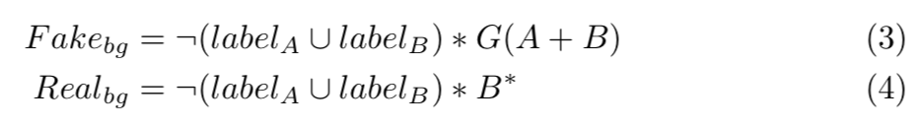
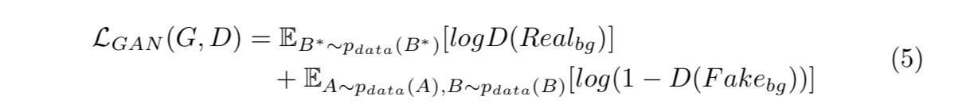
Method
Discriminator:
Expect that the background of Fake B is sufficiently similar to the background of a DSA image
For the structure of the discriminator, PatchGAN is adopted. The adversarial loss between the generator and the discriminator can be expressed as,
Notes:
The IEEE International Symposium on Biomedical Imaging (ISBI)
[sɪmˈpoʊziəm]

Slide 8
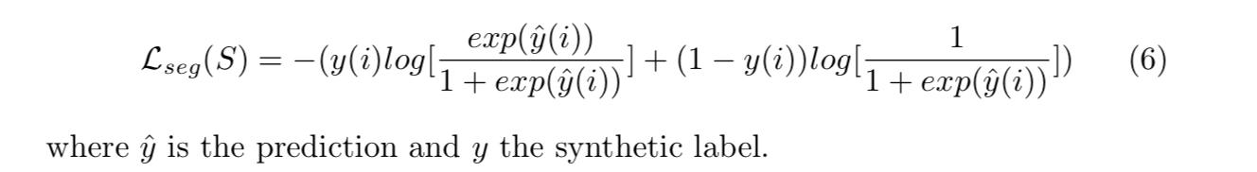
Method
Segmentor:
The main structure of the segmentor is also a U-Net. We use MultiLabelSoftMarginLoss a the objective function of the segmentor
Notes:
The IEEE International Symposium on Biomedical Imaging (ISBI)
[sɪmˈpoʊziəm]

Slide 9
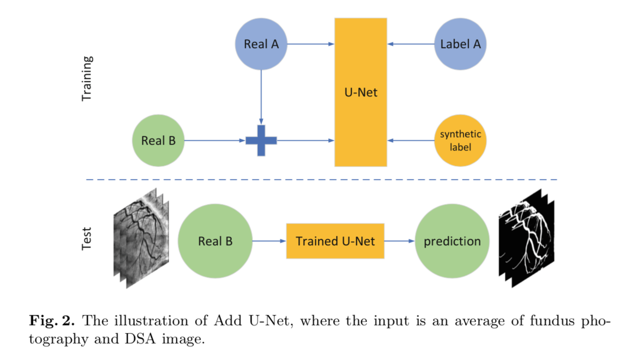
Method
Add-UNet for Comparison
Notes:
The IEEE International Symposium on Biomedical Imaging (ISBI)
[sɪmˈpoʊziəm]

Slide 10
Data
The DRIVE dataset includes 40 fundus images with manually annotated retinal vessels(open source)
Collect 1092 coronary DSA with no annotation as target domain
Size: 512 x 512;
Training set: 50%;
Validation set: 20%
Test set: 30% (328, with annotation)
Notes:
The IEEE International Symposium on Biomedical Imaging (ISBI)
[sɪmˈpoʊziəm]

Slide 11
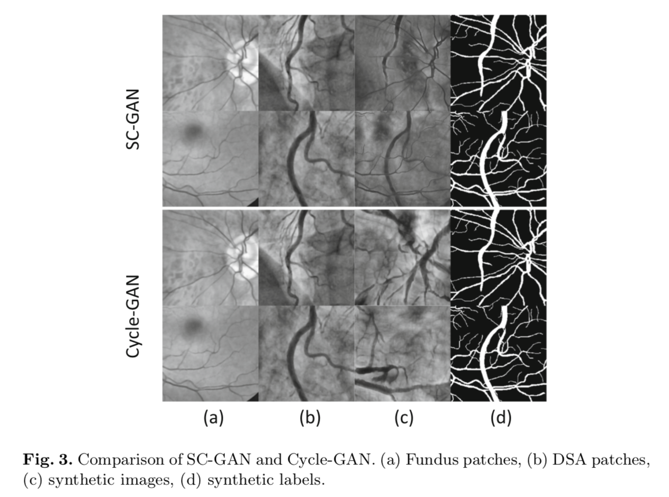
Result
Images synthesis
(a) Real A
(b) Real B
(c) Fake B
More realistic DSA background
Preserve the vascular structures
Notes:
The IEEE International Symposium on Biomedical Imaging (ISBI)
[sɪmˈpoʊziəm]

Slide 12
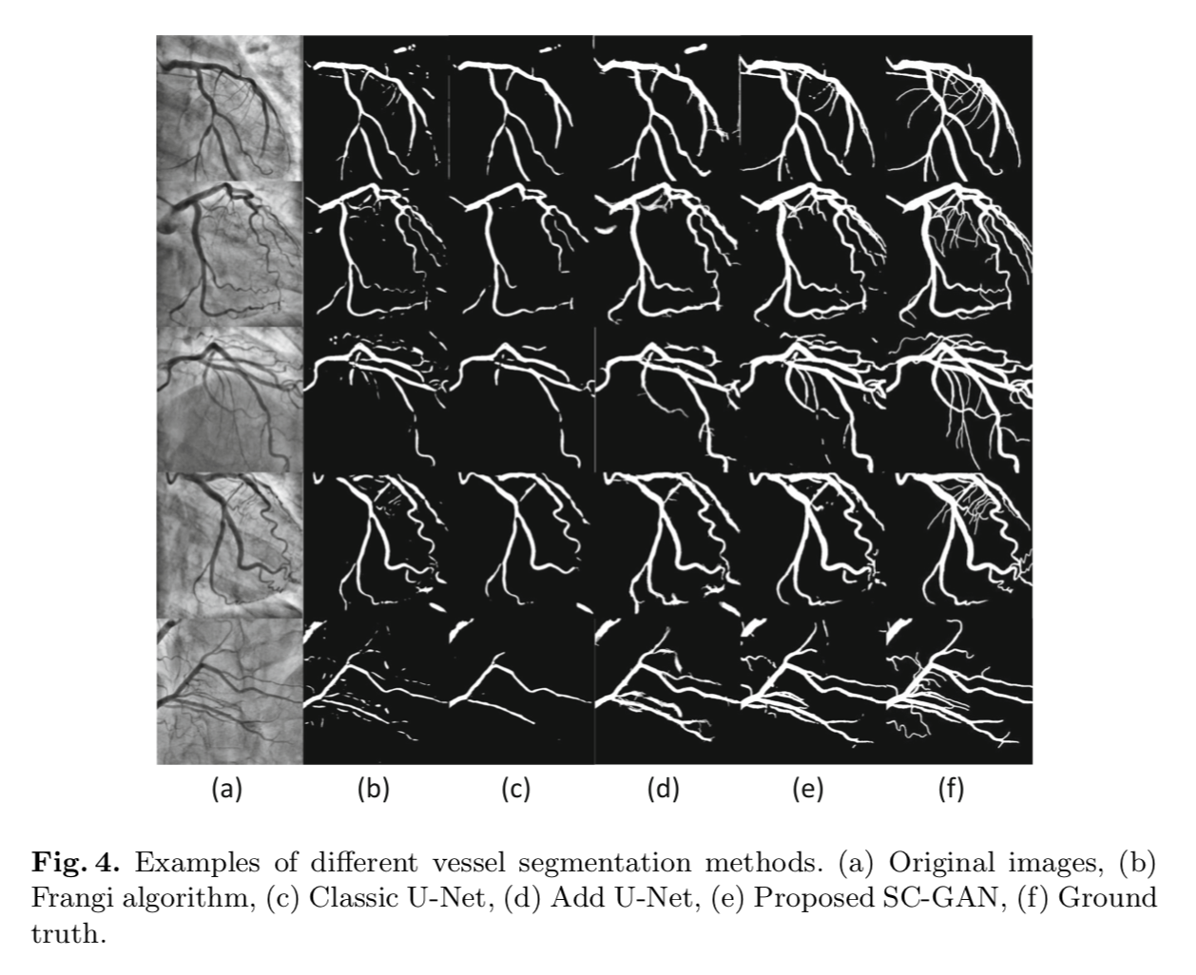
Result
Segmentation
Compare (e) and (F), the segmentation of the small vessels are not good.
Notes:
The IEEE International Symposium on Biomedical Imaging (ISBI)
[sɪmˈpoʊziəm]

Slide 13
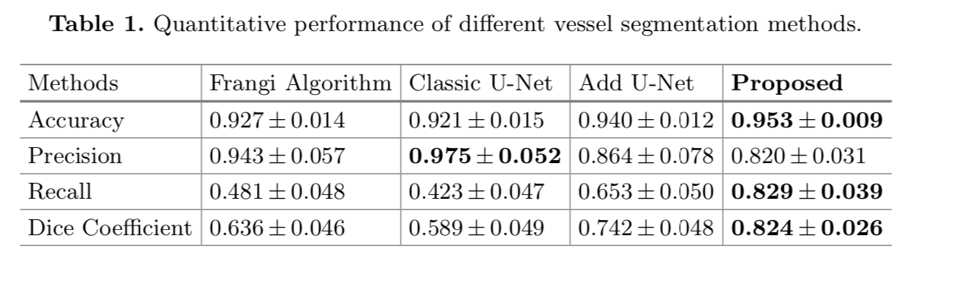
Result
Segmentation
Notes:
The IEEE International Symposium on Biomedical Imaging (ISBI)
[sɪmˈpoʊziəm]

Slide 14
Result
Discussion
SC-GAN obtained an obvious superior performance on coronary arteries segmentation
Further investigation:
1. How well does the method perform on other datasets;
2. Although the segmentor is light-weighted in test, training SC-GAN is much more complex than in a classic supervised deep model.
Notes:
The IEEE International Symposium on Biomedical Imaging (ISBI)
[sɪmˈpoʊziəm]

Slide 15
Thank You!
Notes:
The IEEE International Symposium on Biomedical Imaging (ISBI)
[sɪmˈpoʊziəm]

